Slide 1
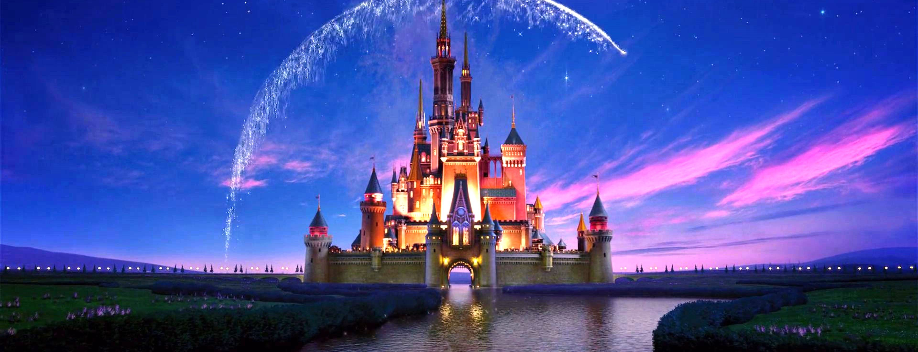

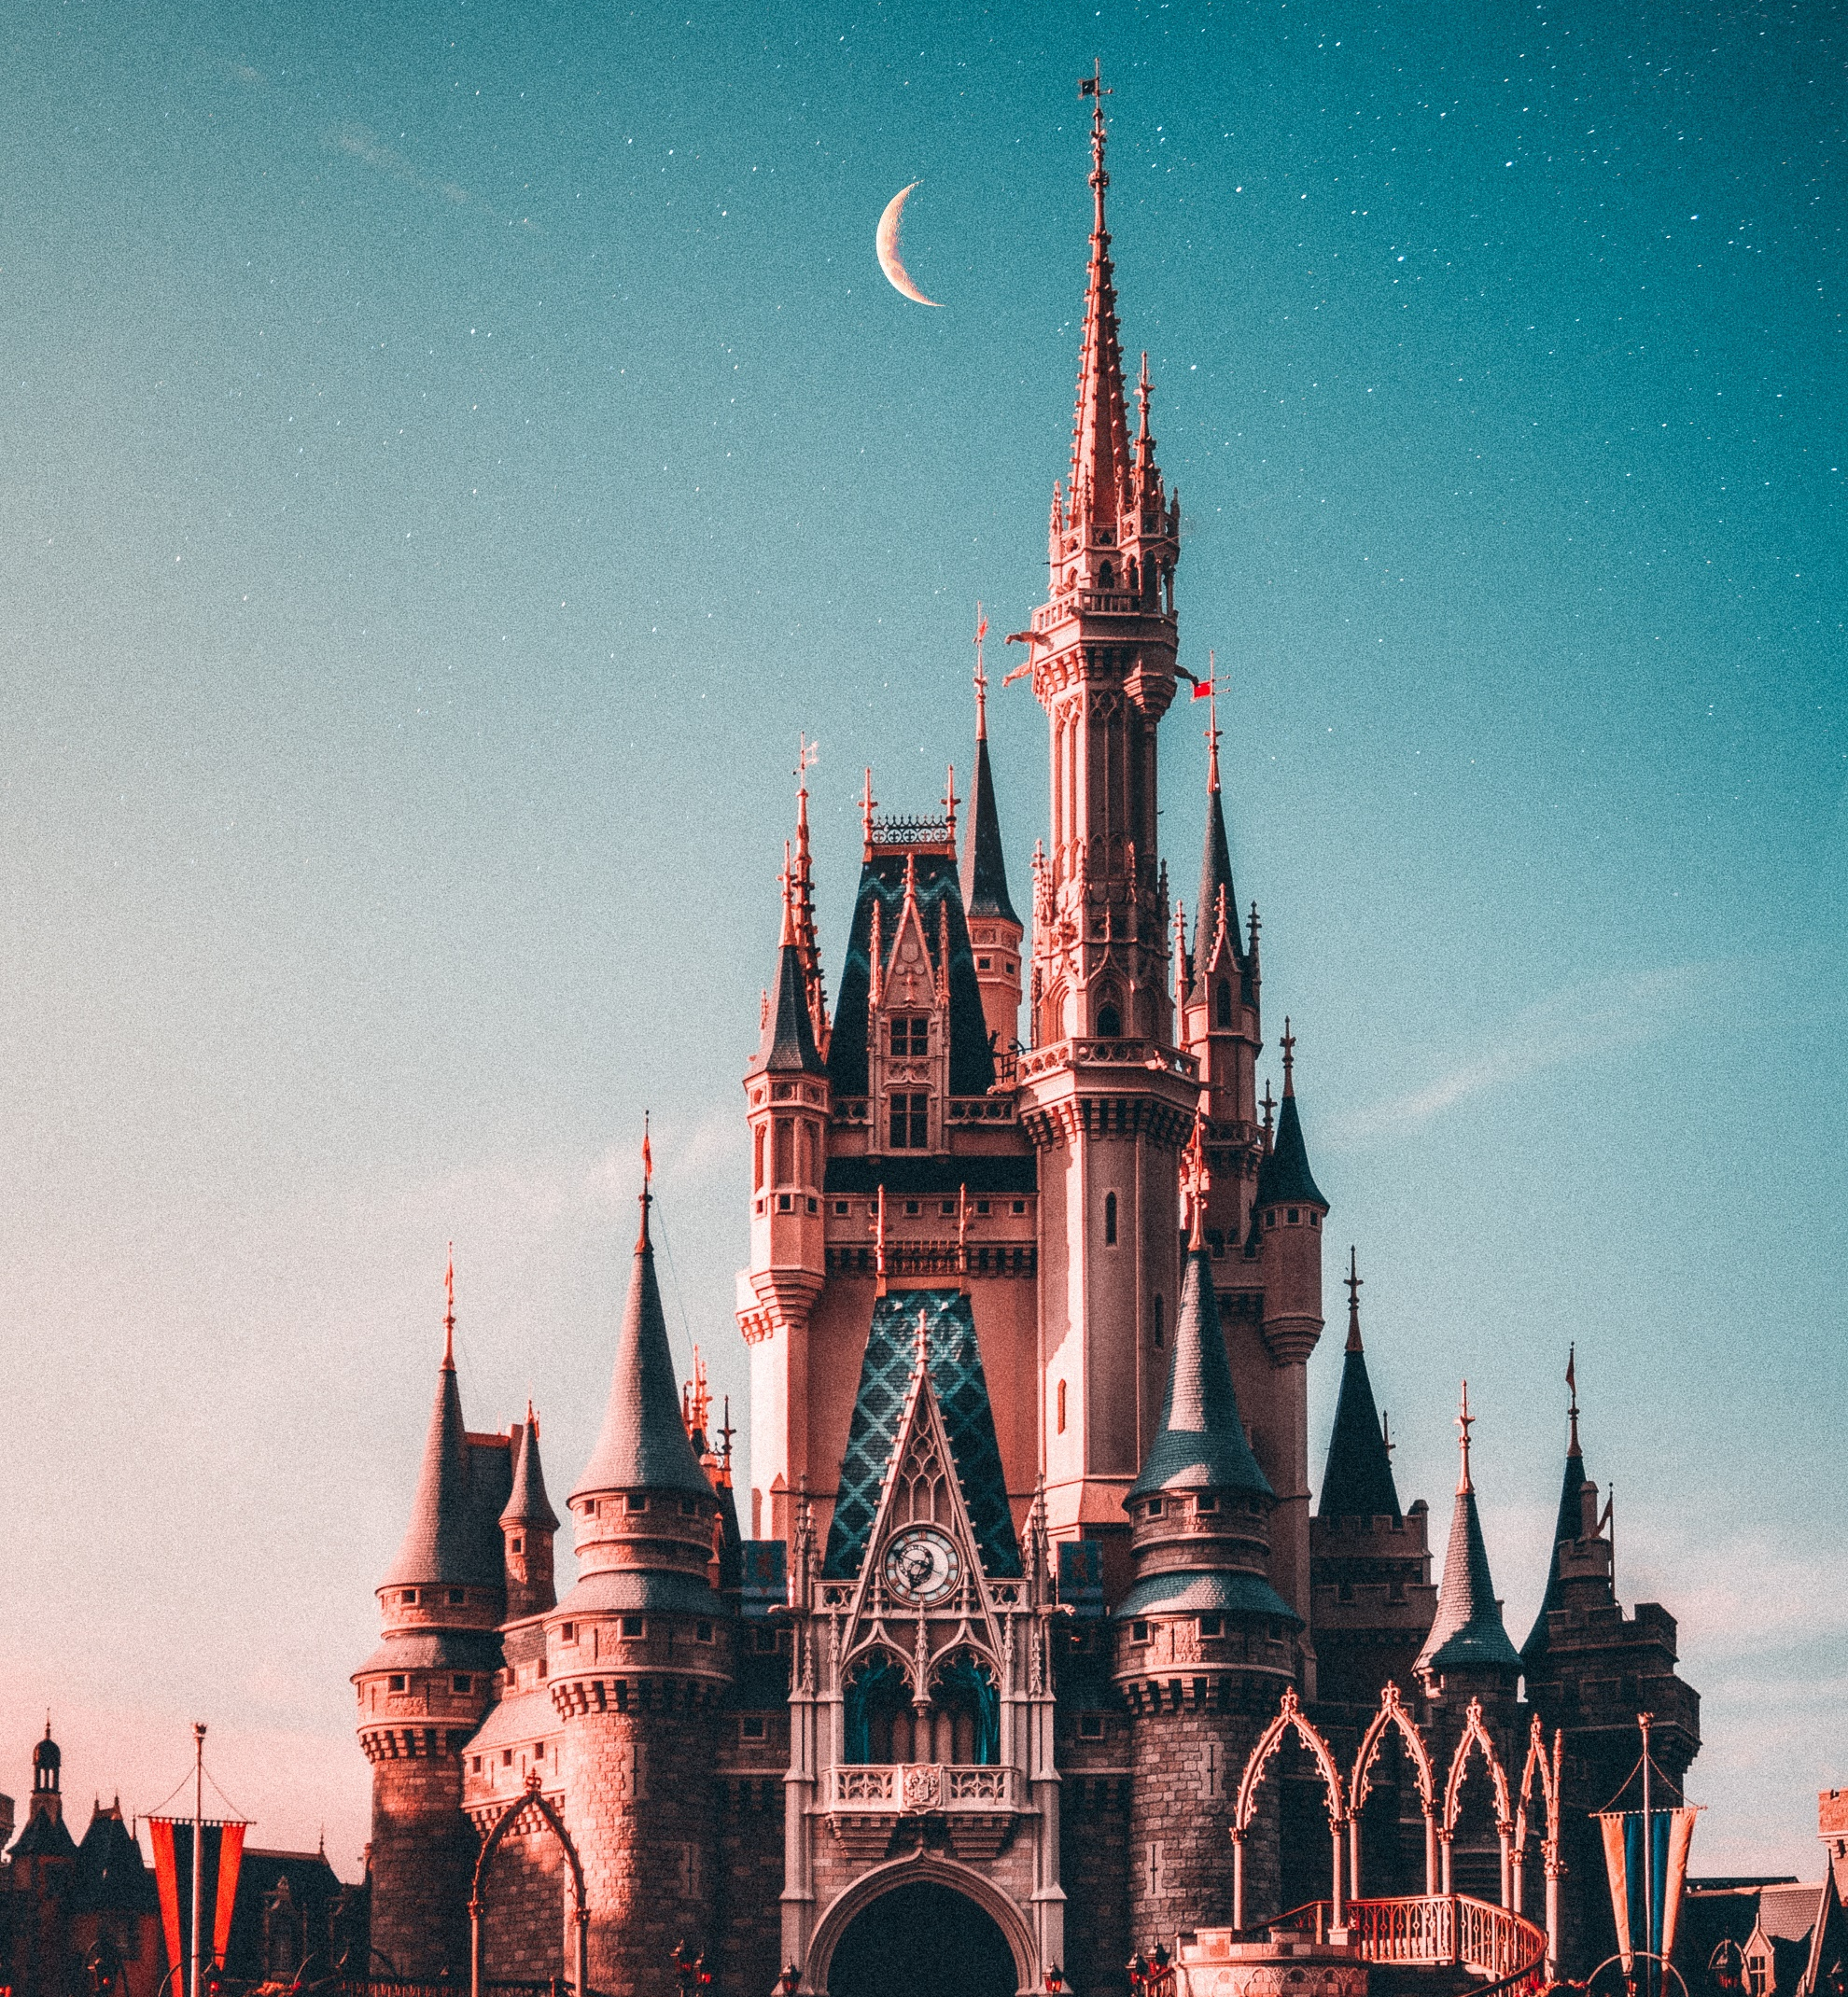
WELCOME TO THE WORLD OF THE WALT DISNEY
TEAM 4
BHAVIKA
BINAL
PRAKUTHI
TITIKSHA
VIDHI

Slide 2
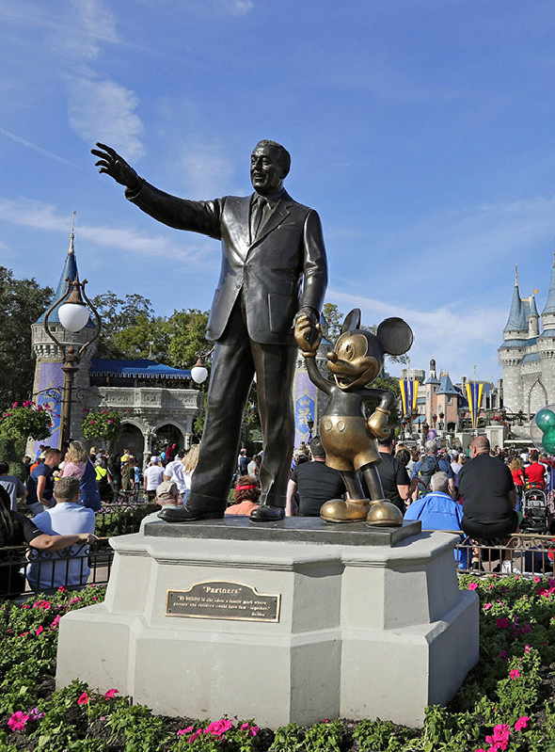
The Walt Disney Company's mission is to inform, entertain and inspire people around the globe via the power of unparalleled storytelling and creative minds, reflecting the iconic brands and innovative technologies that make ours the globe's premier entertainment industry.
Mission
Statement

Slide 3
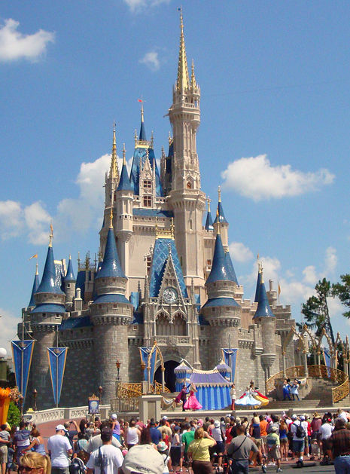
EXECUTIVE
SUMMARY
Welcome to our presentation on the Disney Themed Wedding Department project at Disneyland. Through meticulous scope management, we've crafted a magical journey, leveraging tools and techniques to define our project scope, manage changes effectively, and present a clear Scope Statement. Join us as we navigate the enchanting world of weddings, offering insights and recommendations while embracing the spirit of Disney magic.

Slide 4
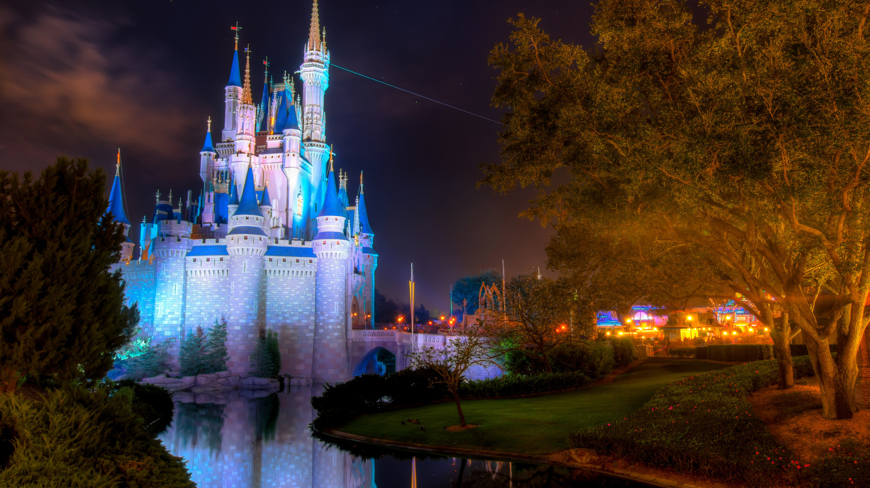
Table Of Content
01
02
03
About Walt Disney
Project Scope
Work Breakdown Structure (WBS)
04
05
Scope Change Management
Scope Statement

Slide 5
Table Of Content
06
07
08
Scope TradeOff
Lessons Learned
Ask Questions

Slide 6
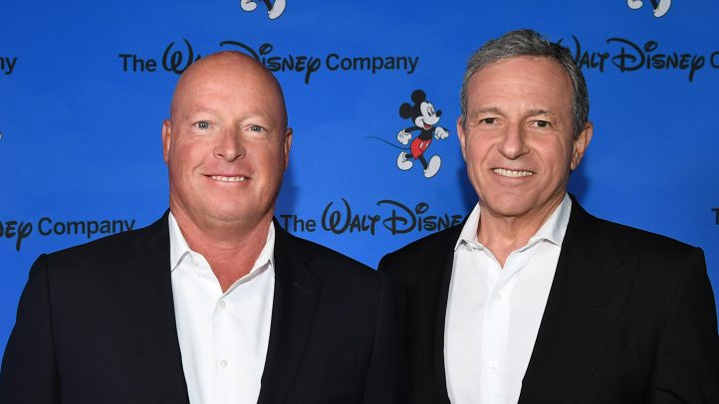
Disney Owners
The Vanguard Group, Inc.
There are Disney Theme Parks in these Locations:
Anaheim, California
Orlando, Florida
Tokyo, Japan
Paris, France
Hong Kong
The BlackRock Inc.

Slide 7





Disney Competitors
Comcast,
Time Warner,
21st Century Fox,
CBS Corp.,
Discovery Communications.

Slide 8
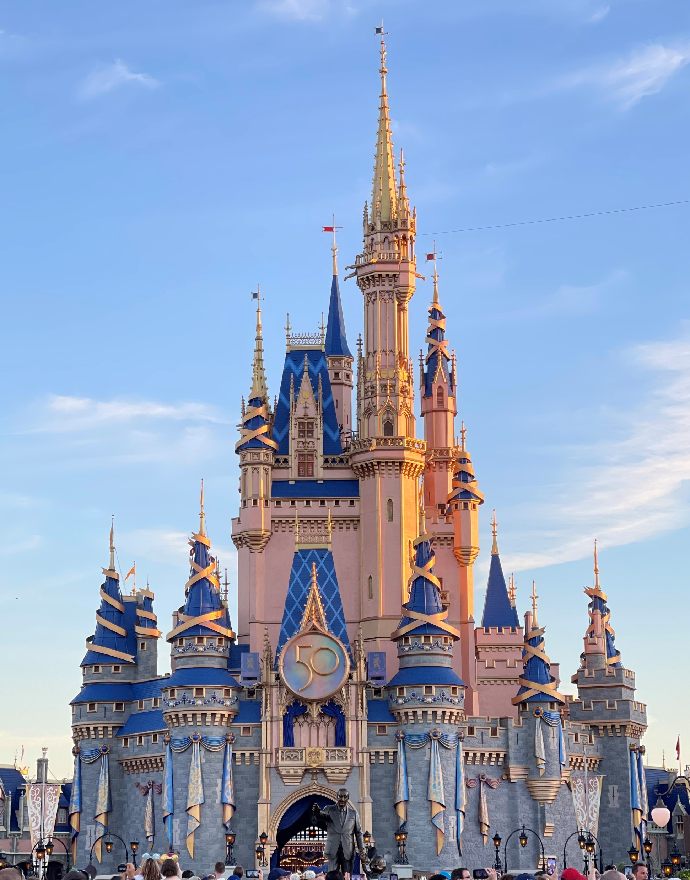
Walt Disney Theme Park
The resort comprises four theme parks (Epcot, Magic Kingdom, Disney's Animal Kingdom, Disney's Hollywood Studios), two water parks (Disney's Typhoon Lagoon and Disney's Blizzard Beach), several golf courses, 31 themed resort hotels, nine non-Disney hotels, and a camping resort, other entertainment venues, including the outdoor shopping inside Disney Springs.

Slide 9
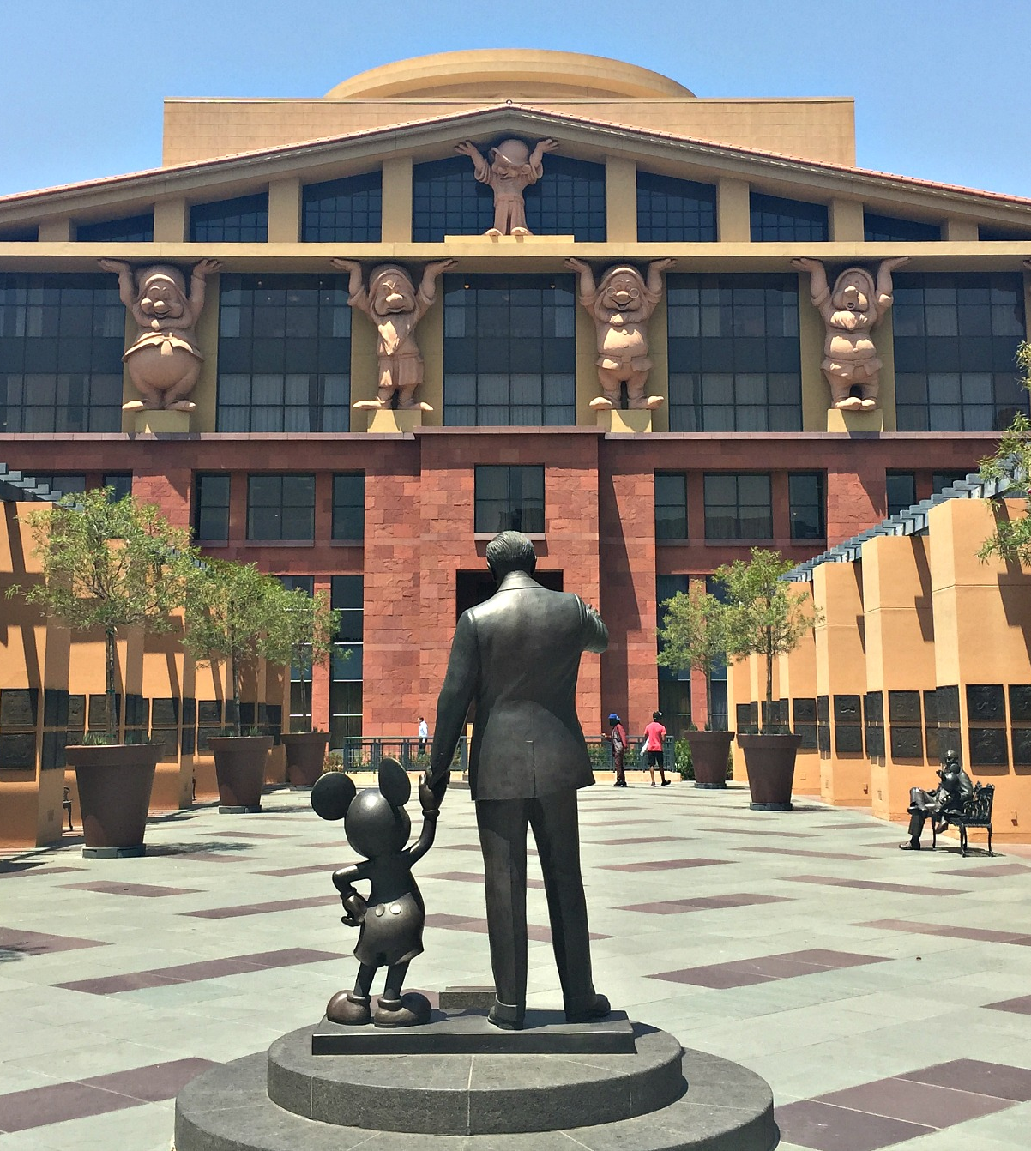
Walt Disney Corporate Structure & Merchandising
Walt Disney Studios
Disney Consumer Products
Media Networks

Slide 10




Famous Characters
Mickey
Mouse
Elsa &
Anna
Donald
Duck
Simba

Slide 11
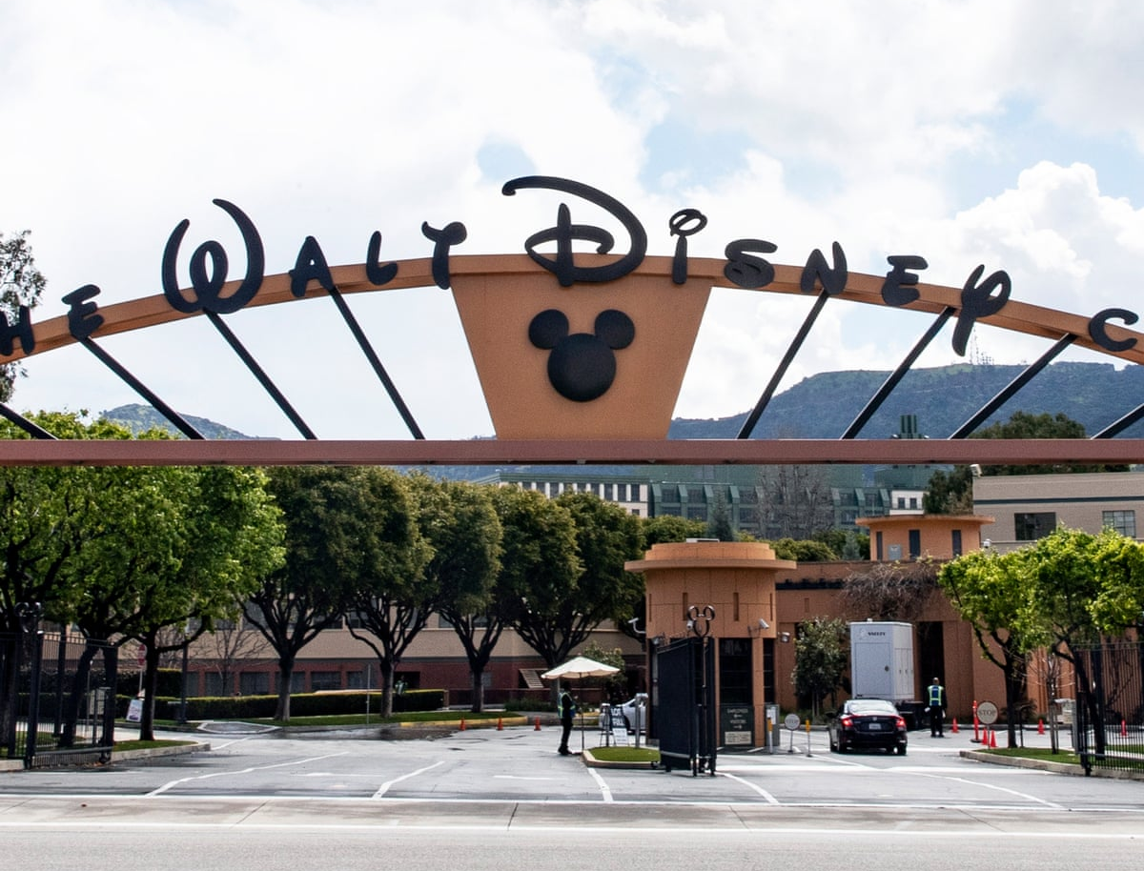
Walt Disney Studios
Walt Disney Pictures
Miramax Films
Buena Vista Home Entertainment
Disney Records
Buena Vista Records
Hollywood Records
Touchstone Pictures
Pixar Animation Studios
Disney Theatrical Group

Slide 12
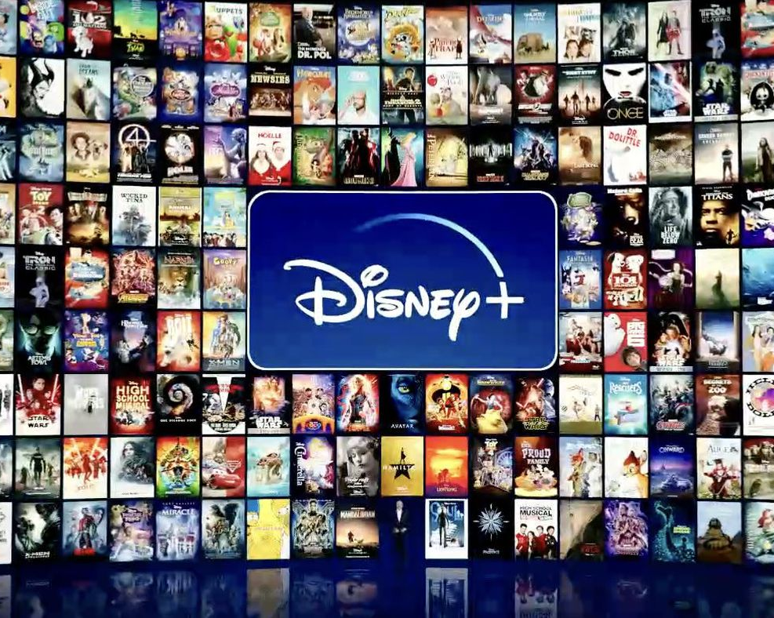
Disney Consumer Products
Disney Hard Lines
Disney Soft Lines
Disney Toys
Disney Press
Disney Publishing Worldwide
Disney Store

Slide 13
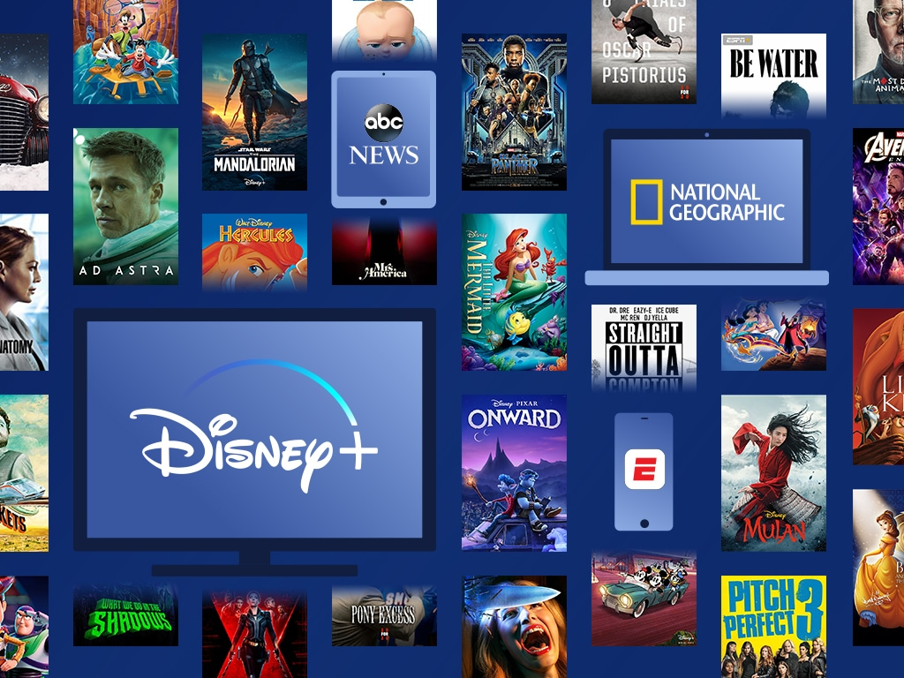
Media Networks
ESPN
Disney/ABC Television Group Digital Media.
Walt Disney Television.
Disney Television Animation.
Disney-ABC International Television-formerly Buena Vista International Television.
ABC Television Network.
ABC News.

Slide 14
SWOT
Analysis Of Disney
Strengths
Reliability
Large Cash Flow
Strong Negotiation Skills
Proficient Team
High Brand Profile
Weaknesses
Sky-High Attribution Rat
Poor Financial Planning
Vulnerable To Competitors
Insufficient Product Demand Scaling
Opportunities
Gear Up for Marketing
Core Competencies
Big Names Are Worth It
Threats
High Expense Toll
Isolation in America
Better Products & Technology

Slide 15
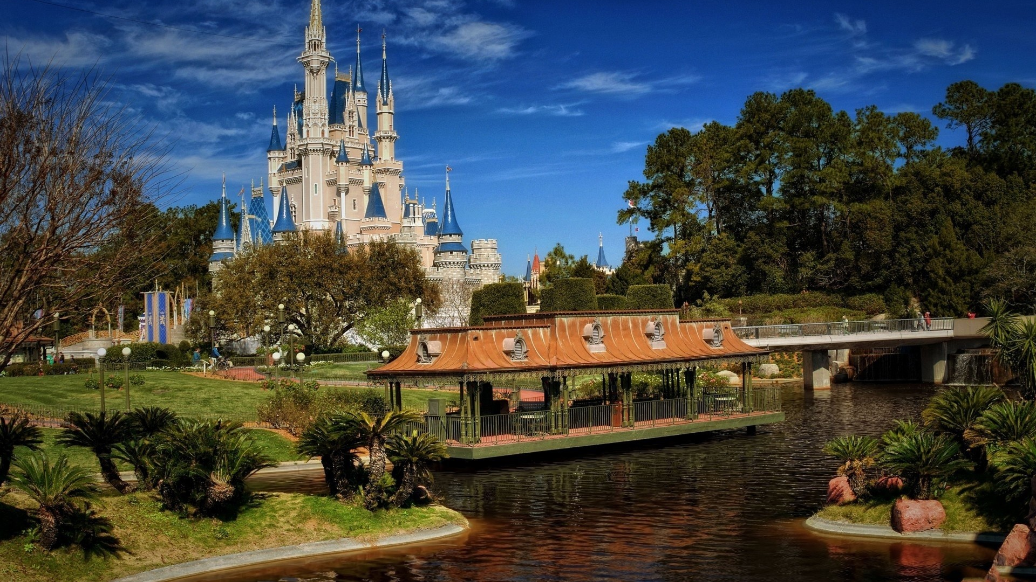
02
PROJECT SCOPE

Slide 16

Project Scope Overview
The scope encompasses the design and execution of enchanting wedding experiences tailored to the dreams and desires of our clients.
This includes venue decoration, entertainment, catering, and personalized services to ensure each wedding reflects the magic of Disney. Additionally, our scope extends to the development of marketing materials, staff training programs, and operational procedures to support the seamless integration of the Disney Themed Wedding Department into Disneyland's offerings.
Through our project, we aim to elevate the wedding experience, creating cherished memories that last a lifetime in the heart of the Happiest Place on Earth.

Slide 17
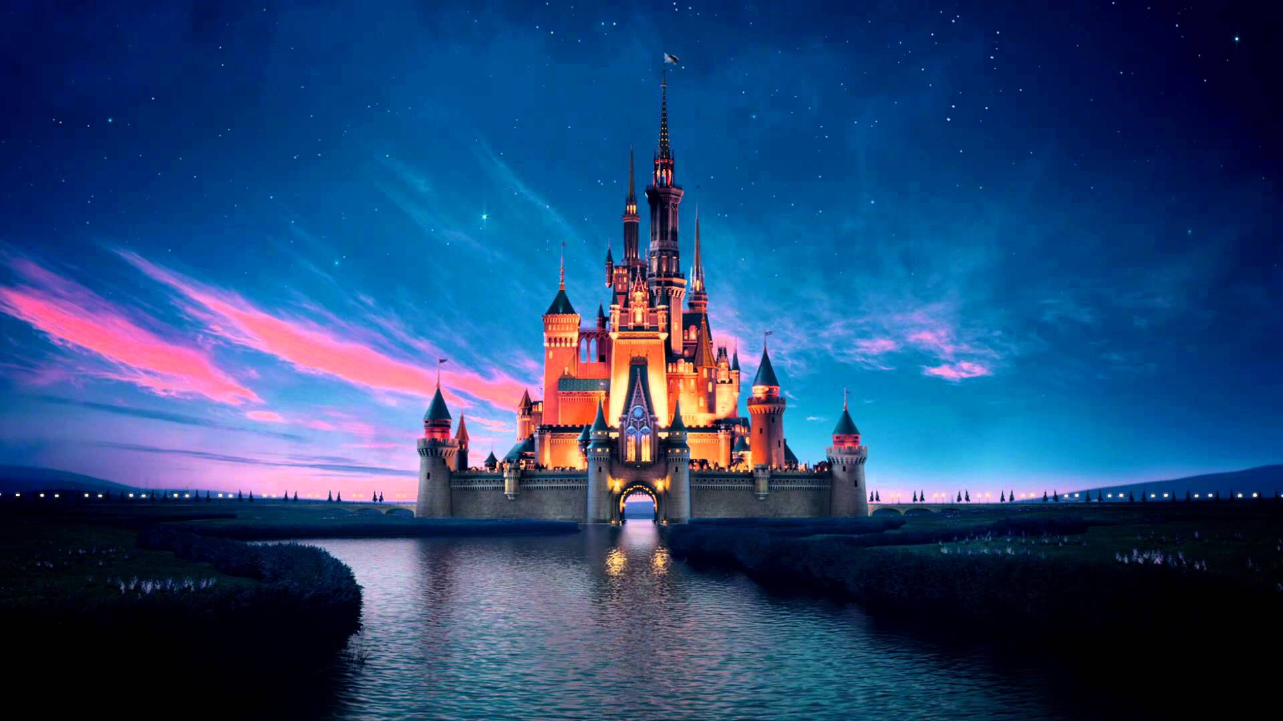
03
Work Breakdown Structure

Slide 18
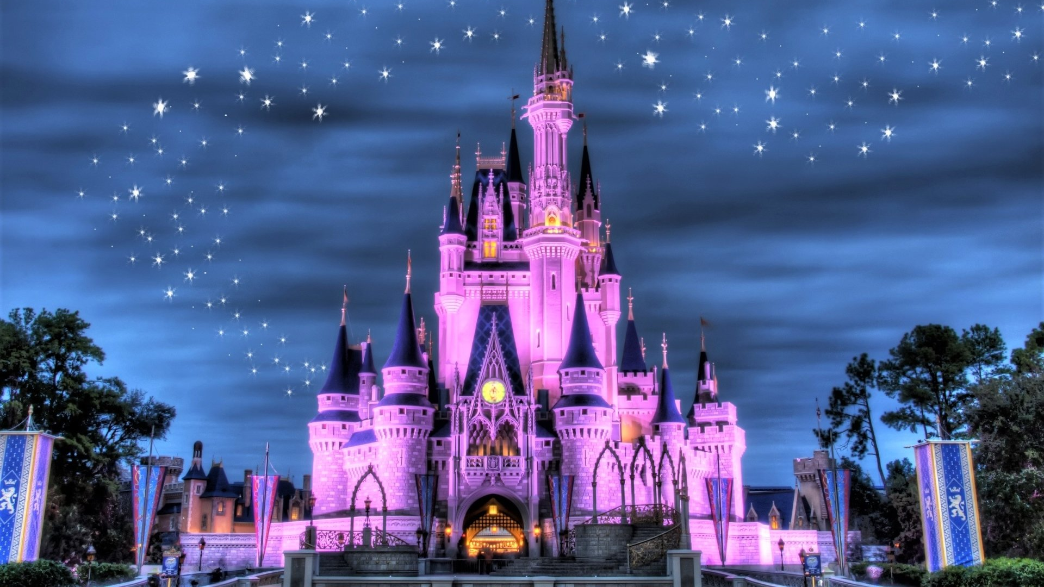
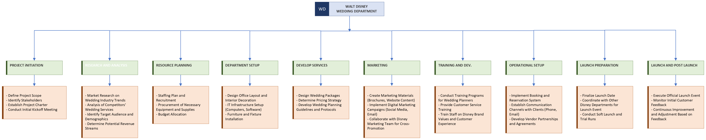

Slide 19
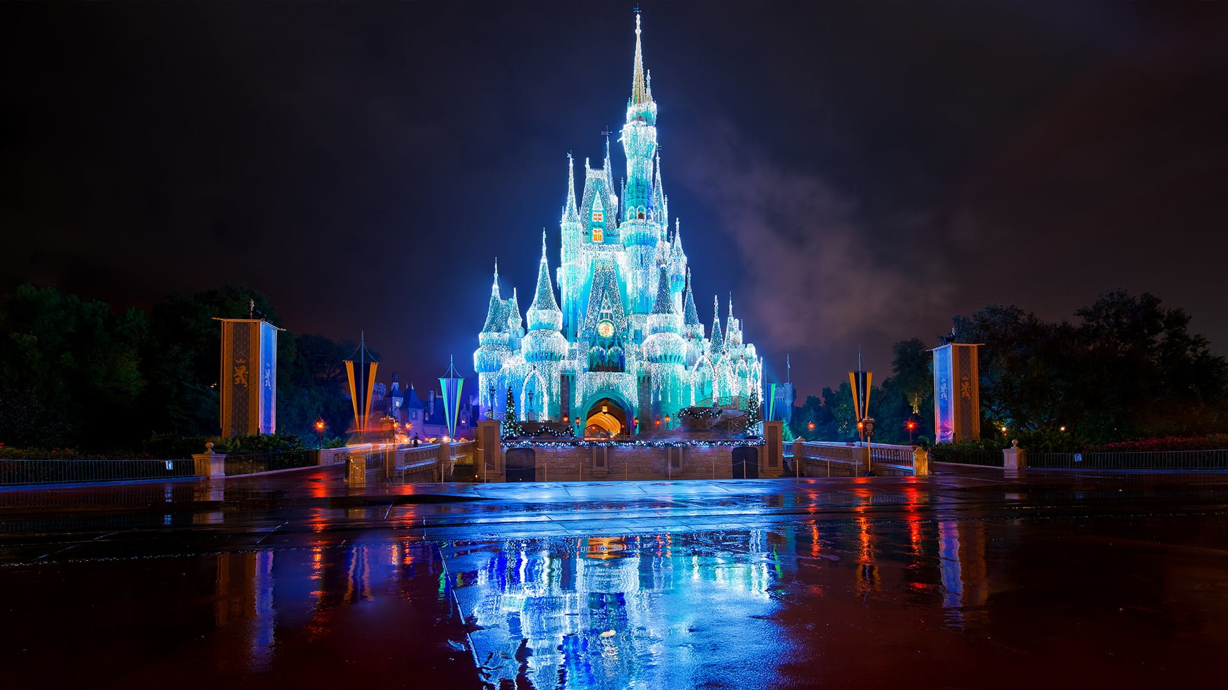
04
Scope Change Management

Slide 20
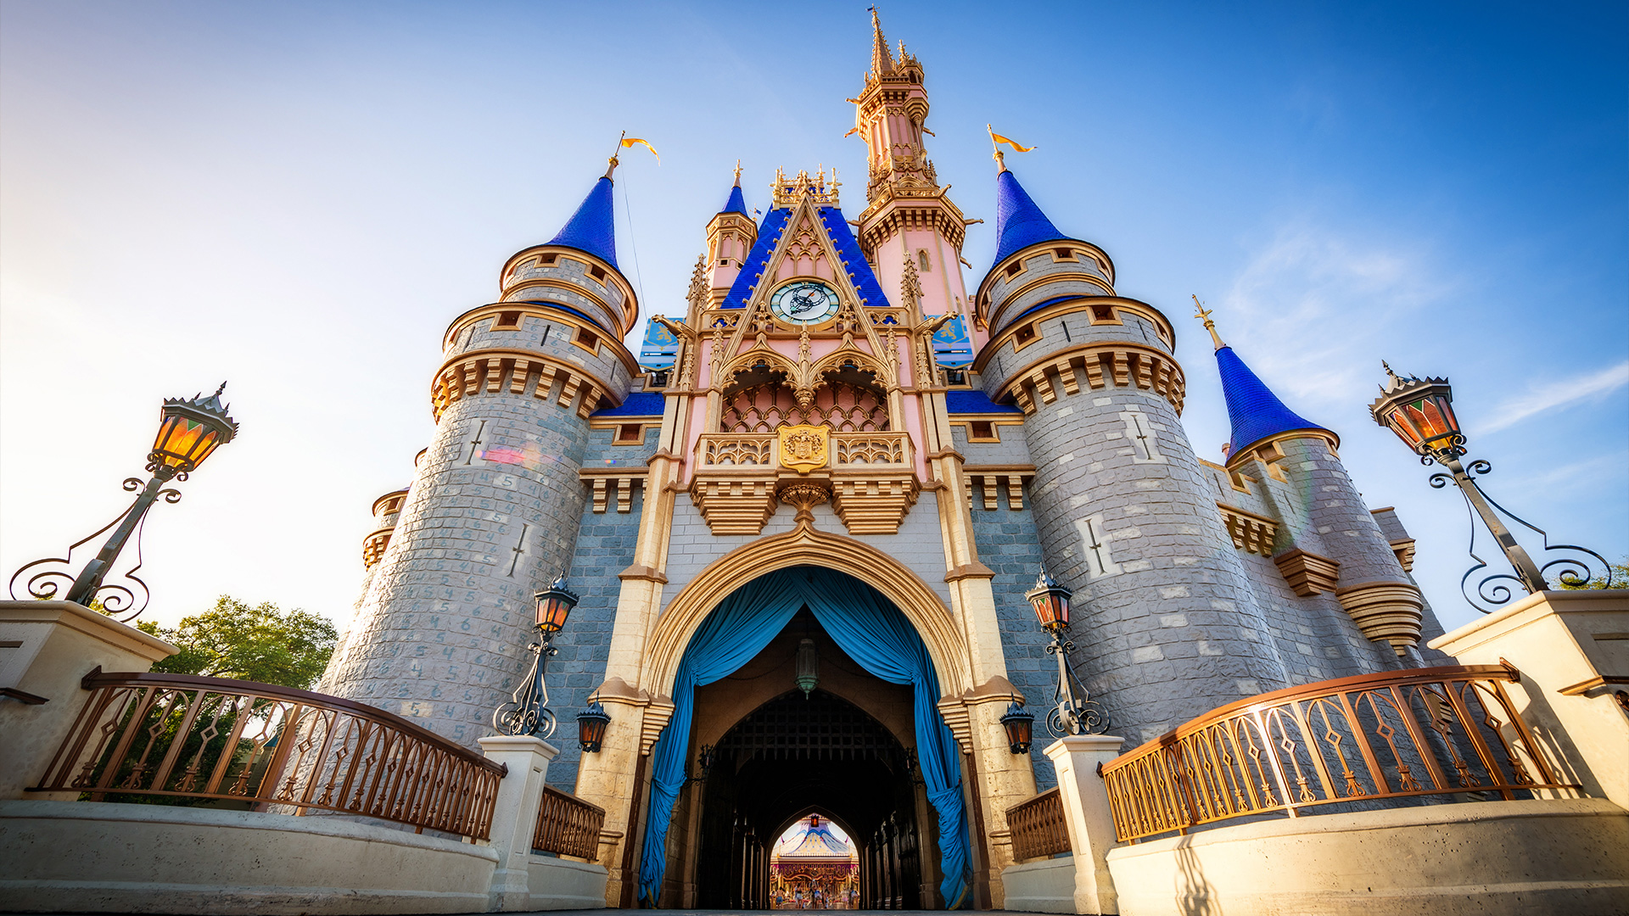
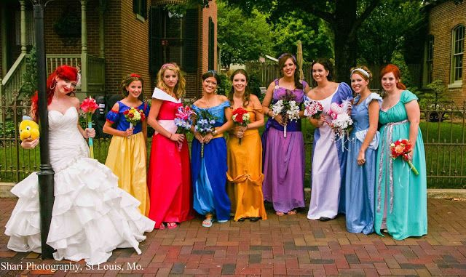
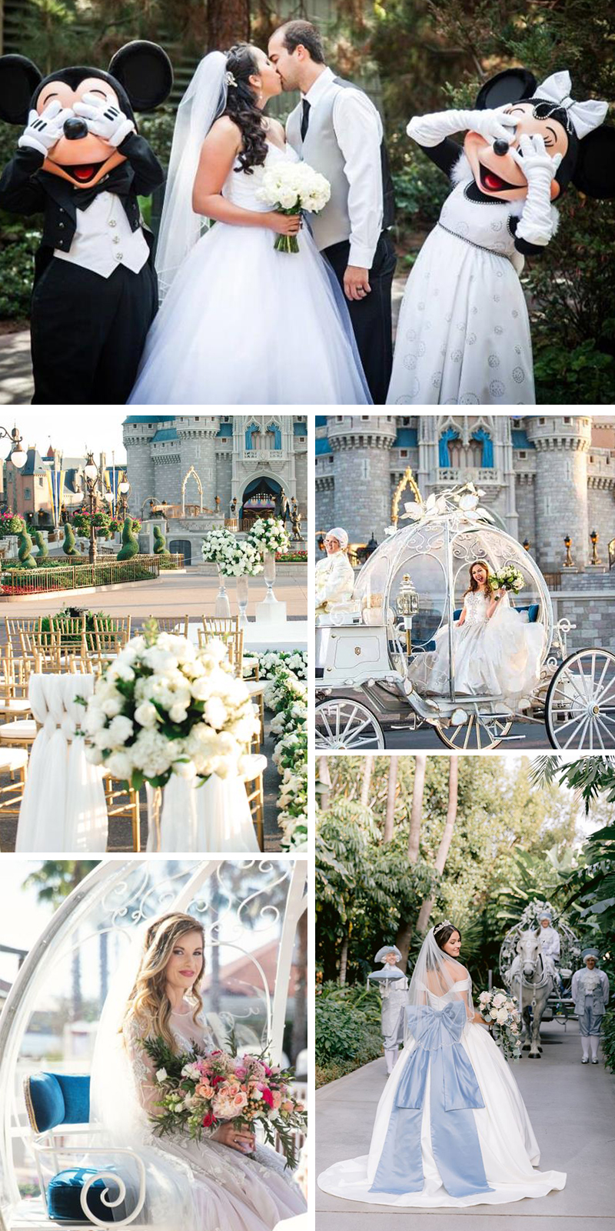
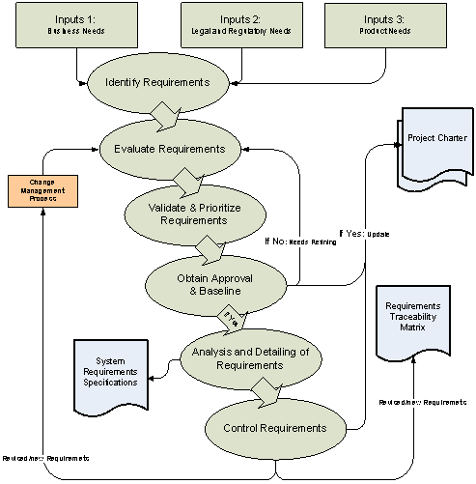
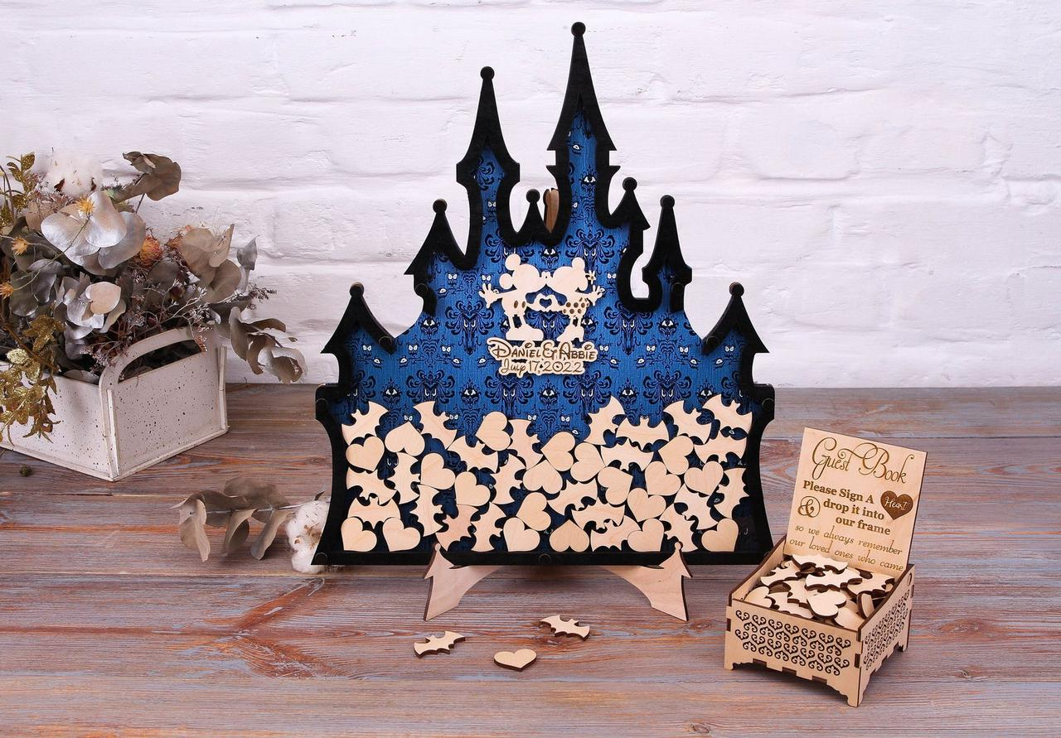

The purpose of the identification close out phase is to ensure an appropriate level of assessment, reporting, evaluation, hand-over exchange, and administrative closure has taken place. A formal close out provides enough directional detail for the (delivery organization) Project Manager to seamlessly proceed to the Delivery Stage.

Slide 21
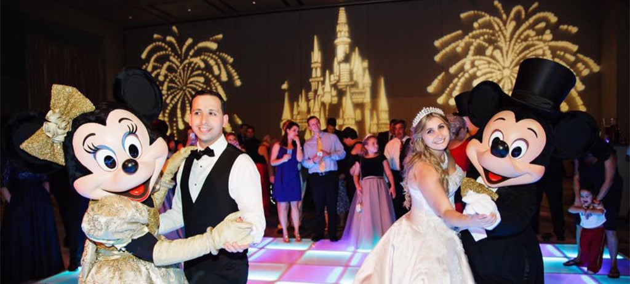
05
Scope Statement

Slide 22

Scope Inclusions:
Design and implementation of themed wedding packages.
Venue decoration and customization to reflect Disney themes.
Entertainment arrangements, including character appearances and live performances.
Catering services offering Disney-inspired menus.
Personalized services, such as wedding planning assistance and concierge support.
Development of marketing materials to promote the Disney Themed Wedding Department.
Staff training programs to ensure exceptional service delivery.
Operational procedures for the efficient management of wedding events.
Project Boundaries:
The project scope is limited to the design and implementation of the Disney Themed Wedding Department within existing Disneyland facilities. It does not extend to the management of guest accommodations, transportation, or other non-wedding related services.
Assumptions:
Availability of existing Disneyland venues for wedding events.
Collaboration with Disney character performers and entertainment teams.
Support from Disneyland management for the integration of the Disney Themed Wedding Department.
Adequate budget allocation for project implementation.
Compliance with relevant legal and regulatory requirements.
Scope Exclusions:
Non-wedding related events or functions.
Major structural modifications to existing Disneyland venues.
Retail merchandise sales unrelated to wedding packages.
Overnight accommodations for wedding guests.

Slide 23
06
Scope Trade Off

Slide 24
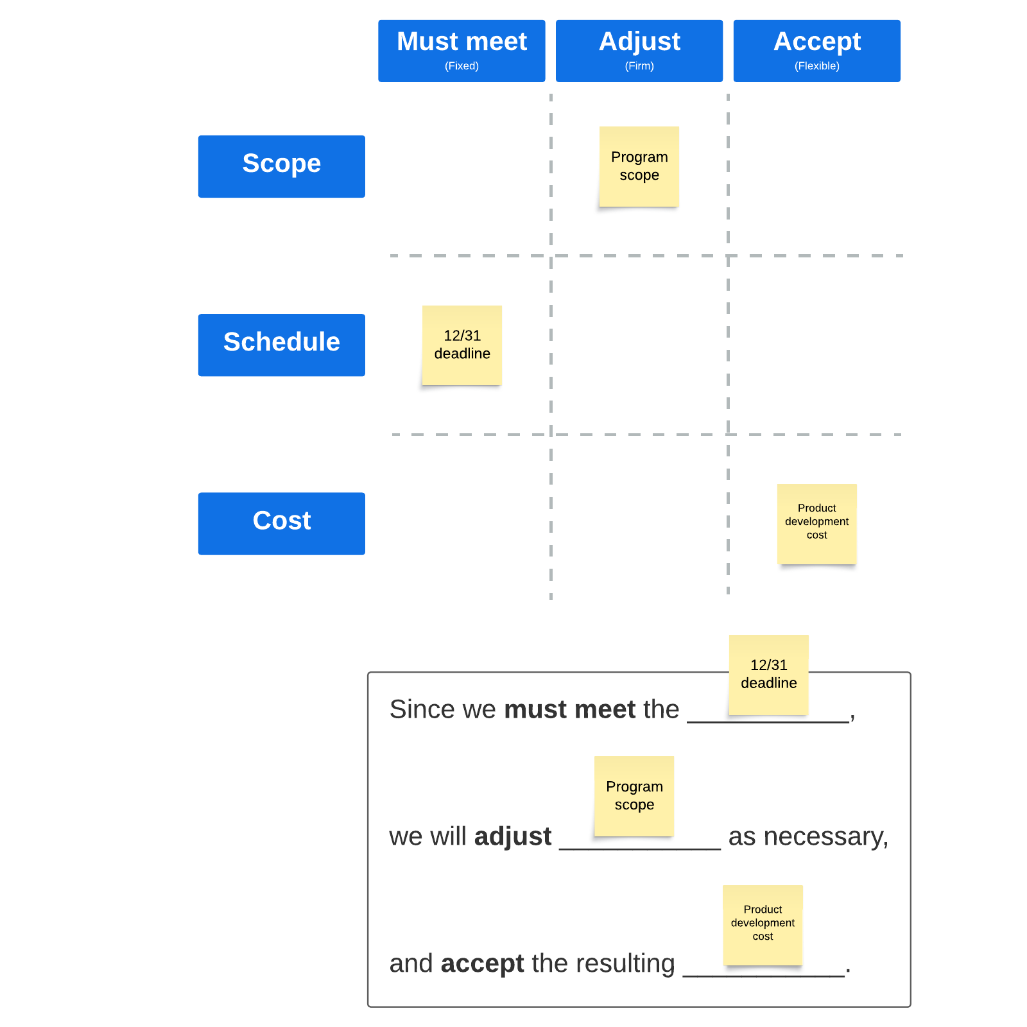
Importance of Flexibility: Recognizing the need for adaptability in ensuring project success.
Proposed Scope Tradeoff: Prioritizing schedule over additional features or enhancements in case of unforeseen challenges or constraints.
Strict Adherence to Timelines: Ensuring timely delivery of the Disney Themed Wedding Department by maintaining adherence to project timelines and milestones.
Deferring Non-Critical Features: Considering the deferral of certain non-critical features or customizations to future phases or iterations.
Mitigating Schedule Risks: The tradeoff aims to mitigate schedule risks while prioritizing core functionalities for launching the Disney Themed Wedding Department.
Seeking Sponsor's Approval: Requesting the sponsor's approval and support for embracing this strategic approach to scope management.
Aligning Efforts with Project Goal: Aligning efforts with the overarching goal of delivering a memorable and magical wedding experience for clients at Disneyland.

Slide 25
07
Lessons Learned

Slide 26
Importance of Stakeholder Engagement:
Lesson: Actively involving stakeholders in scope definition and decision-making processes enhances project alignment and buy-in.
Application: Implement regular communication channels and feedback mechanisms to ensure ongoing stakeholder engagement throughout the project lifecycle.
Effective Change Management Processes:
Lesson: Establishing robust change control procedures enables timely identification, assessment, and mitigation of scope changes.
Application: Implement a formalized change management system with clear protocols for evaluating change requests and assessing their impact on project scope, schedule, and budget.
Risk Identification and Mitigation:
Lesson: Proactively identifying and addressing potential risks minimizes their impact on project scope and objectives.
Application: Conduct comprehensive risk assessments at project initiation and periodically throughout the project lifecycle, implementing risk mitigation strategies to mitigate threats and capitalize on opportunities.

Slide 27
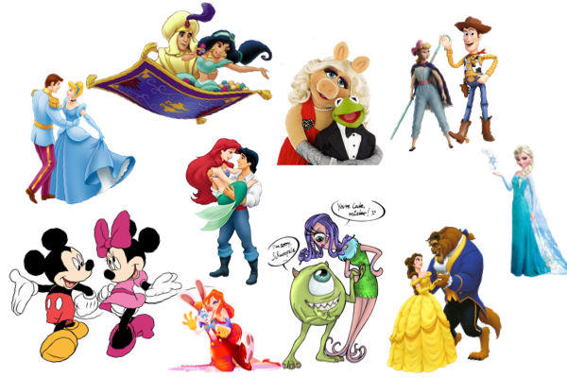

Mirror Mirror On the Wall, is open to questions for all
Thank You

